Slide 1
Classes, Objects and Access Specifiers in java

Slide 2
Examining each part of the main() statement
class MyMain
{
public static void main(String args[])
{
---------
---------
}
}
All Java applications begin execution by calling main( ).
The public keyword is an access specifier, which allows the programmer to control the visibility of class members.
When a class member is preceded by public, then that member may be accessed by code outside the class in which it is declared. (The opposite of public is private, which prevents a member from being used by code defined outside of its class.)

Slide 3
In this case, main( ) must be declared as public, since it must be called by code outside of its class when the program is started.
The keyword static allows main( ) to be called without having to instantiate a particular instance of the class. This is necessary since main( ) is called by the Java Virtual Machine before any objects are made.
The keyword void simply tells the compiler that main( ) does not return a value.
As stated, main( ) is the method called when a Java application begins. Keep in mind that Java is case-sensitive. Thus, Main is different from main.

Slide 4
Any information that you need to pass to a method is received by variables specified within the set of parentheses that follow the name of the method. These variables are called parameters. If there are no parameters required for a given method, you still need to include the empty parentheses.
In main( ), there is only one parameter, albeit a complicated one. String args[ ] declares a parameter named args, which is an array of instances of the class String.
(Arrays are collections of similar objects.) Objects of type String store character strings. In this case, args receives any command-line arguments present when the program is executed

Slide 5
Classes and Objects in Java
In order to design a program using object oriented programming technique, we use classes and objects.
Object is considered as real, physical entity whereas the class is considered as the logical entity.
Objects in Java
Any entity that has a state and exhibits certain behaviors are called objects.
For Eg: bike, pen, car, chair, table etc.
The object can be either physical or logical(conceptual).
A logical entity can be a railway reservation system.
An object exhibits three characteristics:
state: This represents the value of the object.
behaviour: This represents the behaviour of the object. Eg:deposit,withdraw etc.
identity: The object identity is implemented by Java via a unique id. This unique is not visible to the external user but it is used by the JVM to uniquely identify the object

Slide 6
Example: Car is an object. Its name is BMW, color is blue. These represent the states.
The car is used to travel. So travel is its behaviour.
The instance of a class is known as an object. From the class we create objects. Hence we can say that the instance of the class is an object.

Slide 7
Classes in Java
A class constitutes of a group of objects having common properties.
It is a structure from which objects are made.
Class is a conceptual or logical entity.
A class is a collection of fields (data) and methods (procedure or function) that operate on that data.
Circle
centre
radius
circumference()
area()

Slide 8
The General Form of a Class
A class is declared by use of the class keyword. The classes that have been used up to this point are actually very limited examples of its complete form. Classes can (and usually do) get much more complex. A simplified general form of a class definition is shown here:
class classname {
type instance-variable1;
type instance-variable2;
// ...
type instance-variableN;
type methodname1(parameter-list) {
// body of method
}
type methodname2(parameter-list) {
// body of method
}
// ...
type methodnameN(parameter-list) {
// body of method
}
}

Slide 9
The data, or variables, defined within a class are called instance variables.
The code is contained within methods.
Collectively, the methods and variables defined within a class are called members of the class.
In most classes, the instance variables are acted upon and accessed by the methods defined for that class
Variables defined within a class are called instance variables because each instance of the class (that is, each object of the class) contains its own copy of these variables.
Thus, the data for one object is separate and unique from the data for another

Slide 10
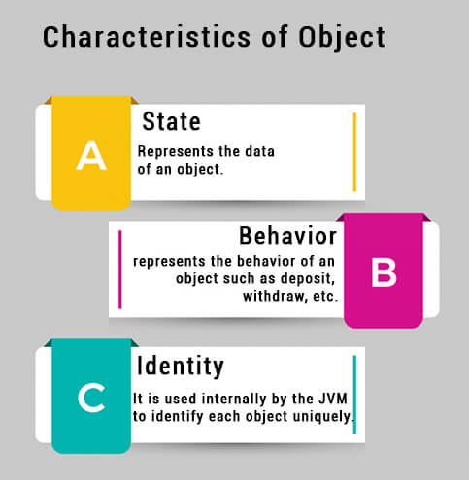
Object in OOP
Object is a basic building block of an OOP language.
We can create an object by creating an instance of a class or instantiating a class.

Slide 11
‘new’ keyword
Used to create an object or instance of the class
It allocates memory (heap) for the newly created object and also returns the reference of that object to that memory.

Slide 12
Heap memory
Java objects reside in an area called the heap.
The heap is created when the JVM starts up and may increase or decrease in size while the application runs.

Slide 13
Syntax for creating an object:
ClassName objectName = new ClassName();

Slide 14
Creating an object using ‘new’ : It can be done in two ways
Declaration and instantiation in single line
MyClass a= new MyClass();
Note: Only declarations doesn’t create objects.
b) Declaration of object , then instantiation in next line.
MyClass a;
a=new MyClass();

Slide 15
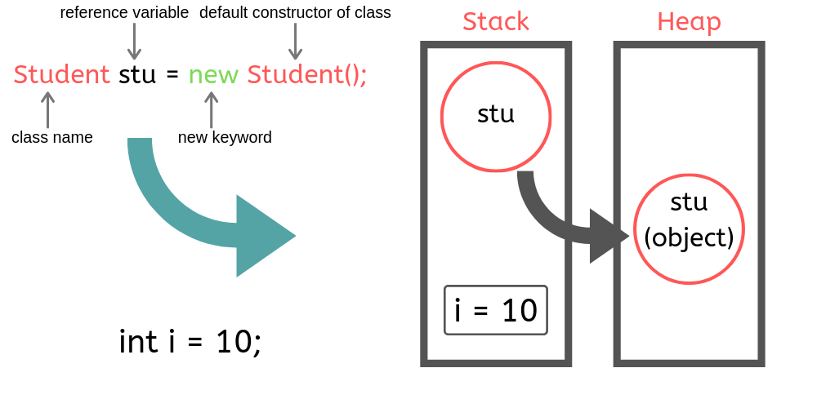
Using new Keyword
Example:
public class Student
{
int i = 10;
public static void main(String[] args)
{
Student stu = new Student();
}
}
KLEF OOPS BES-1

Slide 16
Creating an object using ‘new’
iii) Initialising object
MyClass a= new MyClass();
Performs three actions:
i. declaration,
ii. instantiation, and
iii. initialization.
ii) ‘new’ operator instantiates the MyClass class (thereby creating a new MyClass object)
i) ‘a’ is an object created of type MyClass

Slide 17
Adding Fields: Class Circle with fields
public class Circle {
public double x, y; // centre coordinate
public double r; // radius of the circle
}
Adding Methods
A method exposes the behaviour of an object just like a function.
A class with only data fields has no life.
Objects created by such a class cannot respond to any messages.
Methods are declared inside the body of the class but immediately after the declaration of data fields.
The general form of a method declaration is:
type MethodName (parameter-list)
{
Method-body;
}
17

Slide 18
Creating a class Circle to calculate area and circumference of a circle
public class Circle {
public double x, y; // centre of the circle
public double r; // radius of circle
//Methods to return circumference and area
public double circumference() {
return 2*3.14*r;
}
public double area() {
return 3.14 * r * r;
}
}
Method Body
18

Slide 19
Data Abstraction
Declare the Circle class, have created a new data type – Data Abstraction
Can define variables (objects) of that type: Circle aCircle;
Circle bCircle; // aCircle and bCircle are objects of type Circle class Circle bCircle;
aCircle, bCircle simply refers to a Circle object, not an object itself.
new operator dynamically allocates memory for an object. It has this general form:
class-var = new classname( );

Slide 20
aCircle
bCircle
null
null
Points to nothing (Null Reference)
Points to nothing (Null Reference)

Slide 21
Creating objects of a class
Objects are created dynamically using the new keyword.
aCircle and bCircle refer to Circle objects
bCircle = new Circle() ;
aCircle = new Circle() ;

Slide 22
Creating objects of a class
aCircle = new Circle();
bCircle = new Circle() ;
bCircle = aCircle;
Before Assignment
After Assignment
aCircle
bCircle
aCircle
bCircle
P
Q
P
Q

Slide 23
Accessing Object/Circle Data
Similar to C syntax for accessing data defined in a structure.
ObjectName.VariableName
ObjectName.MethodName(parameter-list)
Circle aCircle = new Circle();
aCircle.x = 2.0 // initialize center and radius
aCircle.y = 2.0
aCircle.r = 1.0

Slide 24
Executing Methods in Object/Circle
Using Object Methods:
sent ‘message’ to aCircle
Circle aCircle = new Circle();
double area;
aCircle.r = 1.0;
area = aCircle.area();

Slide 25
Program to calculate the area and circumference of a circle using Modularization
// Circle.java: Contains both Circle class and its user class
//Add Circle class code here
class Circle{
public double r;
public double area() {
return (3.14*r*r);
}
public double circumference() {
return (2*3.14*r);
}
}
class CalArea{
public static void main(String args[]) {
Circle aCircle; // creating reference
aCircle = new Circle(); // creating object
aCircle.r = 5;
double area = aCircle.area(); // invoking method
double circum = aCircle.circumference();
System.out.println("Radius="+aCircle.r+" Area="+area);
System.out.println("Radius="+aCircle.r+" Circumference ="+circum);
}
}

Slide 26
Modularization & Access Specifiers

Slide 27
Objectives
Students will be able to
Apply modularization – Method and class level Modularization
Understand the usage of Access Specifiers – public, private and default
Apply modularization – Class and package level

Slide 28
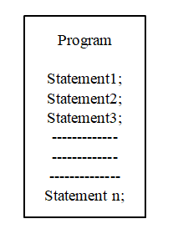
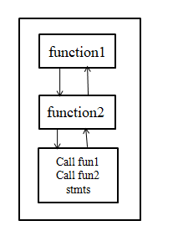
Modularity
Modularity principle suggests dividing a complex system into smaller pieces, called Modules.
Without Modularization
With Modularization

Slide 29
Advantages of Modularity Approach
Ease to use
Reusability
Ease of Maintenance

Slide 30
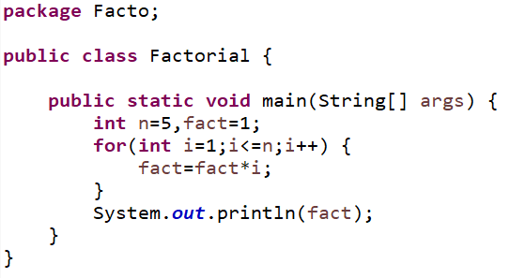
Example : Without Modularization
Finding the factorial of a number

Slide 31
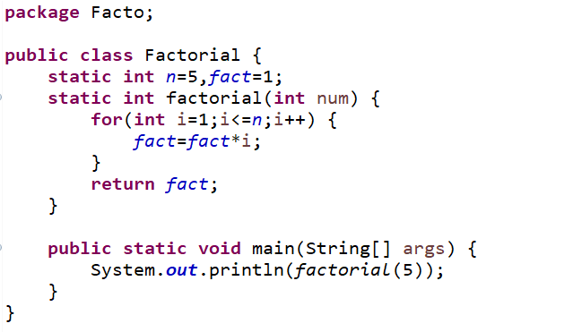
Example : Modularization
Finding the factorial of a number

Slide 32
Class Level Modularization
Class level modularization makes use of modules of one class from another class and vice versa.
class1
class2
function1
function1
function2
function2
function3
function3

Slide 33
Practice Problem:1 Without Modularization
Write a Cuboid class with 3 static variables length, breadth and height of type double, and a static method volume (), access them using main () method within the same class.
Class Diagram:
Cuboid
length : double breadth : double height : double
volume(l : double, b : double, h : double) : void +main(args[] : String) : void

Slide 34
Practice Problem:1-With Modularization
Write a Cuboid class with 3 static variables length, breadth and height of type double, and a static method volume (), access them using main () method within another class Demo.
package1
Cuboid
length : double breadth : double height : double
volume(l : double, b : double, h : double) : void
Demo
+main(args[] : String) : void

Slide 35
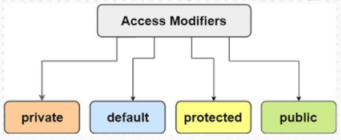
Access Modifiers
The access modifiers specifies the accessibility or scope of a field, method, constructor, or class. We can change the access level of fields, constructors, methods, and class by applying the access modifier on it. There are four types of access modifiers:

Slide 36
Access Modifiers
private: The access level of a private modifier is only within the class. It cannot be accessed from outside the class.
default: The access level of a default modifier is only within the package. It cannot be accessed from outside the package. If you do not specify any access level, it will be the default.
public: The access level of a public modifier is everywhere. It can be accessed from within the class, outside the class, within the package and outside the package.

Slide 37
Understanding Access Modifiers
Access Modifier | Symbol used in class diagram | Within class | Within package | Outside package by subclass only | Outside package
private | - | Y | N | N | N
default | ~ | Y | Y | N | N
protected | # | Y | Y | Y | N
public | + | Y | Y | Y | Y

Slide 38
Example :3 Class Level Modularization
Rewrite the Cuboid class with appropriate Access Specifiers
package1
Cuboid
- length : double - breadth : double - height : double
~volume(l : double, b : double, h : double) : void
Demo
+main(args[] : String) : void

Slide 39
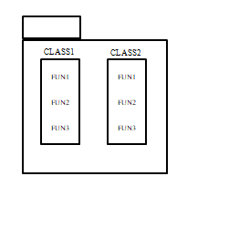
Package level Modularization
Package is a collection of classes. Package level modularization makes use of functions of one package to another package. Accessing permission mainly depends on access modifiers.
package1
package2

Slide 40
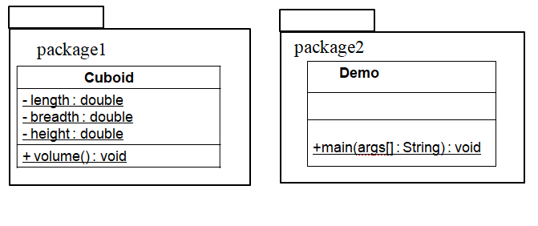
Example :4 Package Level Modularization
Rewrite the Cuboid class with appropriate Access Specifiers to calculate the volume of a Cuboid.

Slide 41
Example :5 Package Level Modularization
To the above modularized code, add a method isCube() that returns true if all dimensions are same, else returns false..
package1
package2
Cuboid
+ length : double + breadth : double + height : double
+ volume() : void
Demo
+ isCube() : boolean +main(args[] : String) : void

